Slide 1
Module 3-Network Layer

Slide 2
Quality of Service: Application Requirements, Traffic Shaping, Packet Scheduling, Admission Control.
Internetworking: How networks differ, How Networks Can Be Connected, Tunneling, Internetwork Routing, Fragmentation; The Network Layer in the Internet: The IPv4 Protocol, IP Addresses, IPv6, Internet Control Protocols.
Chapter 5: 5.4, 5.5, 5.6: 5.6.1-5.6.4, 5.6.6-5.6.8

Slide 3
Quality of Service
Requirements:
A stream of packets from a source to a destination is called a flow.
In a connection-oriented network, all the packets belonging to a flow follow the same route; in a connectionless network, they may follow different routes.
The needs of each flow can be characterized by four primary parameters: reliability, delay, jitter, and bandwidth. Together these determine the QoS (Quality of Service) the flow requires.

Slide 4
Techniques for Achieving Good Quality of Service
Overprovisioning
An easy solution is to provide so much router capacity, buffer space, and bandwidth that the packets just fly through easily. The trouble with this solution is that it is expensive.
Buffering
Flows can be buffered on the receiving side before being delivered. Buffering them does not affect the reliability or bandwidth, and increases the delay, but it smooths out the jitter.

Slide 5
At t = 10 sec, playback begins. At this time, packets 1 through 6 have been buffered so that they can be removed from the buffer at uniform intervals for smooth play. Unfortunately, packet 8 has been delayed so much that it is not available when its play slot comes up, so playback must stop until it arrives, creating an annoying gap in the music or movie.
This problem can be alleviated by delaying the starting time even more, although doing so also requires a larger buffer. Commercial Web sites that contain streaming audio or video all use players that buffer for about 10 seconds before starting to play.

Slide 6
Traffic Shaping
1. Another method of congestion control is to “shape” the traffic before it enters the network. traffic shaping, which smooths out the traffic on the server side, rather than on the client side.
2. Traffic shaping is about regulating the average rate (and burstiness) of data transmission. Used in ATM and Integrated Services networks.
3. At connection set-up time, the sender and carrier negotiate a traffic pattern (shape).
Monitoring a traffic flow is called traffic policing.
Two traffic shaping algorithms are:
Leaky Bucket
Token Bucket

Slide 7
The Leaky Bucket(LB) Algorithm
Imagine a bucket with a small hole in the bottom.
No matter at what rate water enters the bucket, the outflow is at a constant rate when there is any water in the bucket, and zero when the bucket is empty.
Also, once the bucket is full, any additional water entering it spills over the sidesand is lost.

Slide 8
The Leaky Bucket Algorithm used to control rate in a network. It is implemented as a single-server queue with constant service time. If the bucket (buffer) overflows then packets are discarded.
The leaky bucket enforces a constant output rate (average rate) regardless of the burstiness of the input. Does nothing when input is idle.
The host injects one packet per clock tick onto the network. This results in a uniform flow of packets, smoothing out bursts and reducing congestion.
When packets are the same size , the one packet per tick is okay. For variable length packets though, it is better to allow a fixed number of bytes per tick. E.g. 1024 bytes per tick will allow one 1024-byte packet or two 512-byte packets or four 256-byte packets on 1 tick.

Slide 9
The Leaky Bucket(LB) Algorithm

Slide 10
The Token Bucket(TB) Algorithm
In contrast to the LB, the Token Bucket Algorithm, allows the output rate to vary, depending on the size of the burst.
In the TB algorithm, the bucket holds tokens. To transmit a packet, the host must capture and destroy one token.
Tokens are generated by a clock at the rate of one token every Δt sec.
Idle hosts can capture and save up tokens (up to the max size of the bucket) in order to send larger bursts later.

Slide 11
The Token Bucket(TB) Algorithm

Slide 12
Leaky Bucket vs Token Bucket
LB discards packets; TB does not. TB discards tokens.
With TB, a packet can only be transmitted if there are enough tokens to cover its length in bytes.
LB sends packets at an average rate. TB allows for large bursts to be sent faster by speeding up the output.
TB allows saving up tokens (permissions) to send large bursts. LB does not allow saving.

Slide 13
Resource Reservation
Once we have a specific route for a flow, it becomes possible to reserve resources along that route to make sure the needed capacity is available. Three different kinds of resources can potentially be reserved:
1. Bandwidth.
2. Buffer space.
3. CPU cycles.
CPU cycles are also a scarce resource. It takes router CPU time to process a packet, so a router can process only a certain number of packets per second.
Making sure that the CPU is not overloaded is needed to ensure timely processing of each packet.

Slide 14
Admission Control
When a flow is offered to a router, it has to decide, based on its capacity and how many commitments it has already made for other flows, whether to admit or reject the flow.
Because many parties may be involved in the flow negotiation (the sender, the receiver, and all the routers along the path between them), flows must be described accurately in terms of specific parameters that can be negotiated. A set of such parameters is called a flow specification.

Slide 15
Proportional Routing
A different approach that has been proposed to provide a higher quality of service is to split the traffic for each destination over multiple paths.
A simple method is to divide the traffic equally or in proportion to the capacity of the outgoing links.

Slide 16
Packet Scheduling
Fair queueing algorithm:
The essence of the algorithm is that routers have separate queues for each output line, one for each flow.
When a line becomes idle, the router scans the queues round robin, taking the first packet on the next queue.
In this way, with n hosts competing for a given output line, each host gets to send one out of every n packets.

Slide 18
Internetworking
Issues that arise when two or more networks are connected to form an internet.
First of all, the installed base of different networks is large.
Second, as computers and networks get cheaper, the place where decisions get made moves downward in organizations.
Third, different networks have different technology, so as new hardware developments occur, new software will be created to fit the new hardware.

Slide 19
Collection of interconnected networks

Slide 20
How Networks Differ
Problems can occur at the interfaces between networks.
The differing maximum packet sizes used by different networks can be a major issue.
Error, flow, and congestion control often differ among different networks.

Slide 22
How Networks Can Be Connected
In the physical layer, networks can be connected by repeaters or hubs, which just move the bits from one network to an identical network.
One layer up we find bridges and switches, which operate at the data link layer. They can accept frames, examine the MAC addresses, and forward the frames to a different network.
In the network layer, we have routers that can connect two networks. If two networks have dissimilar network layers, the router may be able to translate between the packet formats
A router that can handle multiple protocols is called a multiprotocol router.
In the transport layer we find transport gateways, which can interface between two transport connections.
In the application layer, application gateways translate message semantics.

Slide 23
Two ways of internetworking is possible.(i) a connection-oriented concatenated virtual subnets and (ii) datagram internet.
In the past most networks were connection oriented. Then with the rapid acceptance of the Internet, datagrams became more popular.
In the concatenated virtual-circuit model a sequence of virtual circuit is set up from the source through one or more gateways to the destination. Each gateway maintains tables telling which virtual circuit pass through it.
In datagrams from one host to other host the packets will be routed in different routes through the inter network. A routing decision is made separately for each packet, possibly depending on the traffic at the moment the packet is sent. This strategy can use multiple routes and thus achieve a higher bandwidth than the concatenated virtual circuit model.

Slide 24
The source machine,S, wants to send a packet to the destination machine, D. These machines are on different Ethernets, connected by a switch. S encapsulates the packet in a frame and sends it on its way. The frame arrives at the switch, which then determines that the frame has to go to LAN 2 by looking at its MAC address. The switch just removes the frame from LAN 1 and deposits it on LAN 2.

Slide 25
Tunneling
Making two different networks interwork is exceedingly difficult.
This case is where the source and destination hosts are on the same type of network, but there is a different network in between. The solution to this problem is a technique called tunneling.
To send an IP packet to host 2, host 1 constructs the packet containing the IP address of host 2, inserts it into an Ethernet frame addressed to the Paris multiprotocol router, and puts it on the Ethernet.
When the multiprotocol router gets the frame, it removes the IP packet, inserts it in the payload field of the WAN network layer packet, and addresses the latter to the WAN address of the London multiprotocol router.
When it gets there, the London router removes the IP packet and sends it to host 2 inside an Ethernet frame.

Slide 28
Internetwork Routing
Once the graph has been constructed, known routing algorithms, such as the distance vector and link state algorithms, can be applied to the set of multiprotocol routers.
This gives a two level routing algorithm: within each network an interior gateway protocol is used, but between the networks, an exterior gateway protocol is used (''gateway'' is an older term for ''router'').
Because each network in an internetwork is independent of all the others, it is often referred to as an Autonomous System (AS).

Slide 29
Fragmentation
Break up packets into fragments, sending each fragment as a separate internet packet

Slide 30
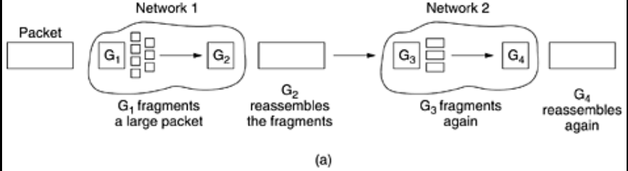
Transparent fragmentation.:
In this approach, the small-packet network has gateways that interface to other networks.
When an oversized packet arrives at a gateway, the gateway breaks it up into fragments.
Each fragment is addressed to the same exit gateway, where the pieces are recombined.
In this way passage through the small-packet network has been made transparent. Subsequent networks are not even aware that fragmentation has occurred.

Slide 31
Problem:
when it has received all the pieces, so either a count field or an ''end of packet'' bit must be provided.
For another thing, all packets must exit via the same gateway.
A last problem is the overhead required to repeatedly reassemble and then refragment a large packet passing through a series of small-packet networks.

Slide 32
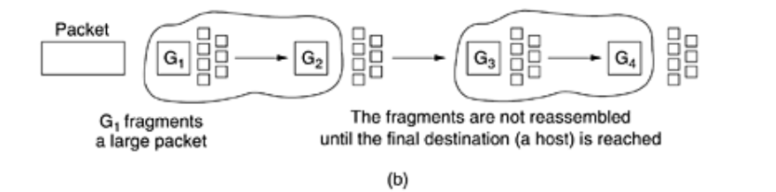
Nontransparent fragmentation:
The other fragmentation strategy is to refrain from recombining fragments at any intermediate gateways.
Once a packet has been fragmented, each fragment is treated as though it were an original packet.
Recombination occurs only at the destination host. IP works this way.

Slide 33
Problem:
it requires every host to be able to do reassembly.
another problem is that when a large packet is fragmented, the total overhead increases because each fragment must have a header.
An advantage :
multiple exit gateways can now be used and higher performance can be achieved.

Slide 35
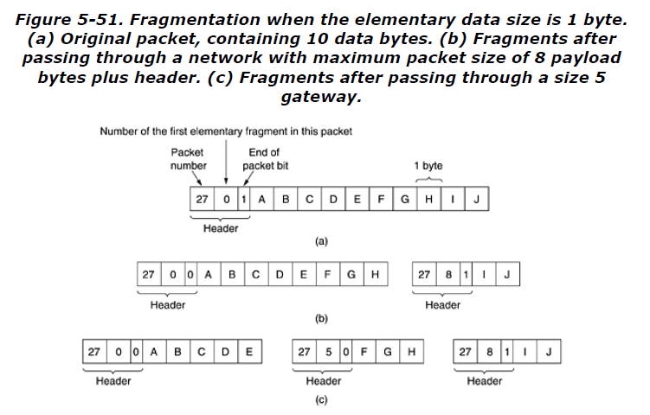

Slide 36
Integrated Services
Integrated Services (IntServ) was developed by the IETF between 1995 and 1997 to support streaming multimedia, such as video and audio, over the Internet.
It aimed to provide Quality of Service (QoS) by reserving network resources for specific data flows.
The system was designed for both unicast (one-to-one) and multicast (one-to-many) communication.
In multicast, users can join or leave a group dynamically—like people entering or exiting a video conference.
Because of these changing group memberships, pre-reserving bandwidth for all receivers is impractical, especially for large audiences.

Slide 37
RSVP—The Resource reSerVation Protocol
To solve this, the IETF introduced the Resource reSerVation Protocol (RSVP), described in RFC 2205.
RSVP handles the reservation of resources such as bandwidth along the communication path but does not transmit data itself.
It allows multiple senders and receivers to communicate efficiently while avoiding network congestion.
RSVP operates over multicast routing, where each group is assigned a group address and packets are sent along a spanning tree connecting all members.
The main difference from normal multicast is that RSVP sends extra control messages to routers so they can maintain the necessary data structures for QoS reservations.

Slide 38
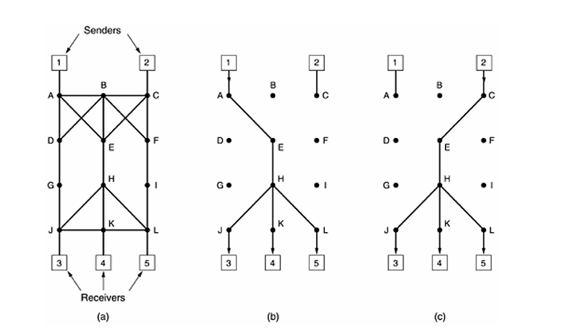
As an example, consider the network of Fig. (a) . Hosts 1 and 2 are multicast senders, and hosts 3, 4, and 5 are multicast receivers. In this example, the senders and receivers are disjoint, but in general, the two sets may overlap. The multicast trees for hosts 1 and 2 are shown in Fig. (b) and Fig. (c) , respectively.

Slide 39
Any receiver in a multicast group can send a reservation message toward the sender to request better reception and avoid congestion.
This message travels up the spanning tree using the reverse path forwarding algorithm, and each router along the way reserves the required bandwidth.
If all routers along the path can reserve the needed bandwidth, a complete end-to-end reservation is established; otherwise, the receiver is informed of the failure.

Slide 40
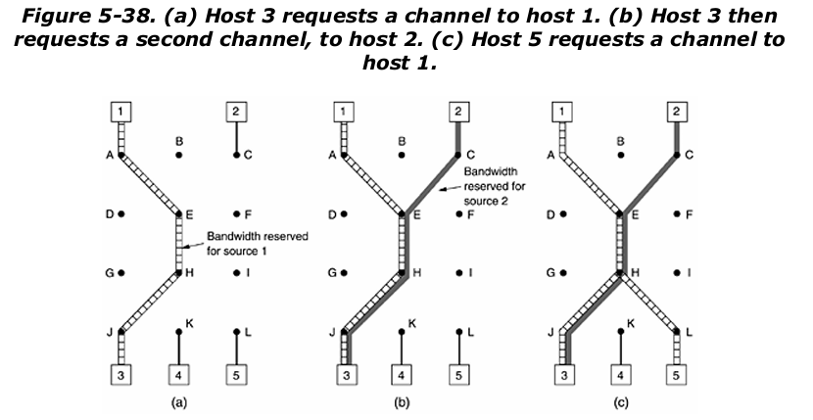
An example of such a reservation is shown in Fig. 5-38(a) . Here host 3 has requested a channel to host 1. Once it has been established, packets can flow from 1 to 3 without congestion. Now consider what happens if host 3 next reserves a channel to the other sender, host 2, so the user can watch two television programs at once. A second path is reserved, as illustrated in Fig. 5-38(b) . Note that two separate channels are needed from host 3 to router E because two independent streams are being transmitted.
Finally, in Fig. 5-38(c) , host 5 decides to watch the program being transmitted by host 1 and also makes a reservation. First, dedicated bandwidth is reserved as far as router H. However, this router sees that it already has a feed from host 1, so if the necessary bandwidth has already been reserved, it does not have to reserve any more. Note that hosts 3 and 5 might have asked for different amounts of bandwidth (e.g., 3 has a black-and-white television set, so it does not want the color information), so the capacity reserved must be large enough to satisfy the greediest receiver.

Slide 41
When making a reservation, a receiver can specify which source(s) it wants to receive data from and indicate whether these sources are fixed or can be changed later.
Routers use this information to plan bandwidth efficiently—shared paths are created only if all receivers agree not to change sources later.
In the dynamic case, reserved bandwidth is independent of the source, allowing receivers to switch between sources (like different video streams) without needing a new reservation.

Slide 42
The Network Layer in the Internet
Principles of Network Layer:
1. Make sure it works. Do not finalize the design or standard until multiple prototypes have successfully communicated with each other.
2. Keep it simple. When in doubt, use the simplest solution.
3. Make clear choices. If there are several ways of doing the same thing, choose one. Having two or more ways to do the same thing is looking for trouble.
4. Exploit modularity. This principle leads directly to the idea of having protocol stacks, each of whose layers is independent of all the other ones. In this way, if circumstances that require one module or layer to be changed, the other ones will not be affected.

Slide 43
5. Expect heterogeneity. Different types of hardware, transmission facilities, and applications will occur on any large network. To handle them, the network design must be simple, general, and flexible.
6. Avoid static options and parameters. If parameters are unavoidable (e.g.,maximum packet size), it is best to have the sender and receiver negotiate a value than defining fixed choices.
7. Look for a good design; it need not be perfect. Often the designers have a good design but it cannot handle some weird special case. Rather than messing up the design, the designers should go with the good design and put the burden of working around it on the people with the strange requirements.

Slide 44
8. Be strict when sending and tolerant when receiving. In other words, only send packets that rigorously comply with the standards
9. Think about scalability. If the system is to handle millions of hosts and billions of users effectively, no centralized databases of any kind are tolerable and load must be spread as evenly as possible over the available resources.
10. Consider performance and cost. If a network has poor performance or outrageous costs, nobody will use it.

Slide 45
IP (Internet Protocol)
The glue that holds the whole Internet together is the network layer protocol, IP (Internet Protocol).
Its job is to provide a best-efforts way to transport datagrams from source to destination, without regard to whether these machines are on the same network or whether there are other networks in between them.
Communication in the Internet works as follows:
  Each datagram is transmitted, after getting from Transport layer, through the Internet, possibly being fragmented into smaller units as it goes.
  When all pieces finally get to the destination machine, they are reassembled by the network layer into the original datagram.

Slide 46
The IP Protocol
IP transports data in packets called Datagrams, each of which is transported separately.
Datagrams may travel along different routes and may arrive out of sequence or duplicated. IP does not create virtual circuits for delivery.
Packets in IP layer are called Datagrams.

Slide 47
IPV4
An IP datagram consists of a header part and a text part.
The header has a 20-byte fixed part and a variable length optional part.

Slide 49
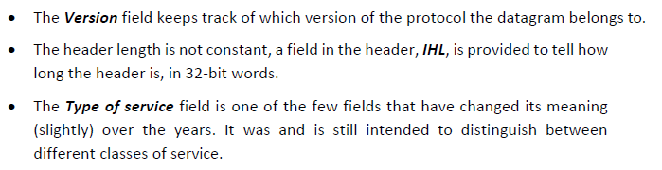
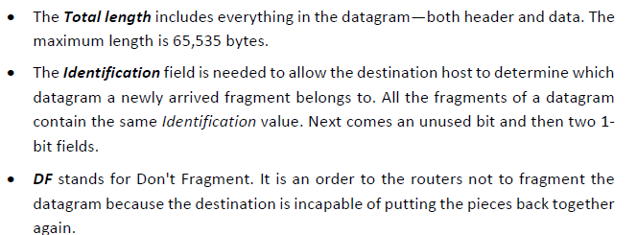

Slide 50
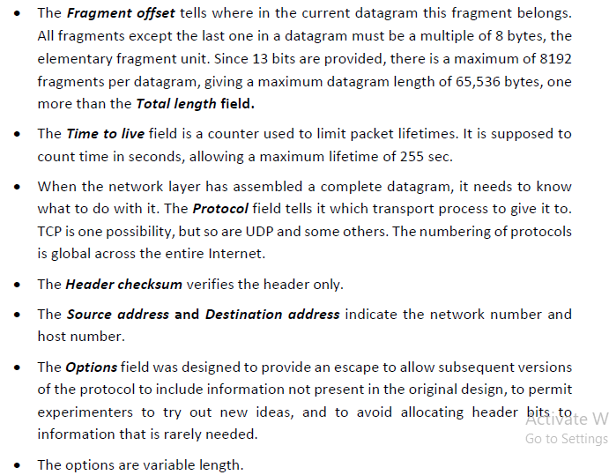

Slide 51
Version
  The first field defines the version number of the IP.
  The current version is 4(IPv4),with binary value 0100.
Header length (HLEN)
  The HLEN field defines the length of the header in multiples of four bytes .
  The four bits can represent a number between 0 to 15,which,when multiplied by 4,gives a maximum of 60 bytes.
Service Type
  The service type field defines how datagram should be handled.
  It includes bits that define the priority of the datagram. Precedence (3 bits): Priority (0–7). D, T, R flags: Delay, Throughput, Reliability preferences.
  It also contains bits that specify the type of service the sender desires such as the level of throughput, reliability, and delay
Total Length
  The total length field defines the total length of the IP datagram.
  It is a two-byte field (16 bits) and can define up to 65,535 bytes.

Slide 52
Identification
  The identification field is used in fragmentation.
  A datagram, when passing through different networks, may be divided into fragments to match the network frame size.
  All fragments share the same identification number.
Flags
  The bits in the flags field deal with fragmentation (the datagram can or can not be fragmented; can be first, middle, or last fragment; etc.).
  DF (Don’t Fragment): Prevents routers from fragmenting the packet.
  MF (More Fragments): Set on all fragments except the last.
  Helps manage fragmentation and reassembly.
Fragmentation offset
  The fragmentation offset is a pointer that shows the offset of the data in the original datagram (if it is fragmented).
  The Fragment offset tells where in the current datagram this fragment belongs.

Slide 53
Time to live
  The time to live field defines the number of hops a datagram can travel before it is discarded.
  The source host, when it creates the datagram, sets this field to an initial value.
  Then, as the datagram travels through the Internet, router by router, each router decrements this value by 1.
  If this value becomes 0 before the datagram reaches its final destination, the datagram is discarded.
  This prevents a datagram from going back and forth forever between routers.
Protocol
  The protocol field defines which upper-layer protocol data are encapsulated in datagram (TCP, UDP, ICMP etc.).
Header Checksum
  Verifies errors in the header only.
  This is a 16-bit field used to check the integrity of the header, not the rest of the packet.
Source address
  The source address field is a four-byte (32-bit) Internet address.
  It identifies the original source of the datagram.
Destination address
  The destination address field is a four-byte (32-bit) Internet address.
  It identifies the final destination of the datagram.
Options
  The options field gives more functionality to IP datagram.
  It can carry fields that control routing, timing, management, timestamp and alignment

Slide 54
IP Addresses
IP address is a numeric identifier assigned to each machine on the internet.
IP address consists of two parts: network ID(NID) and host ID(HID).
NID identifies the network to which the host is connected. All the hosts connected to the same network have the same NID.
HID is used to uniquely identify a host on that network.
HID is assigned by the network-administrator at the local site.
NID for an organization may be assigned by the ISP (Internet Service Provider).
IPv4 uses 32-bit addresses, i.e., approximately 4 billion addresses (232).
IP addresses are usually written in dotted-decimal notation. The address is broken into four bytes.
For example, an IP address of 10000000 10000111 01000100 00000101 is written as 128.135.68.5

Slide 55
The combination is unique: in principle, no two machines on the Internet have the same IP address.
IP address does not actually refer to a host. It really refers to a network interface, so if a host is on two networks, it must have two IP addresses. However, in practice, most hosts are on one network and thus have one IP address.
All IP addresses are 32 bits long and are used in the Source address and Destination address fields of IP packets.
IP address can be classified as
Classful IP addressing & Classless IP addressing (CIDR- Classless Inter Domain Routing)

Slide 56
IPv4 Classful Addressing
In classful addressing, the address space is divided into five classes:
  A, B, C, D and E.
Classes A, B and C are used for unicast addressing.
Class D was designed for multicasting and class E is reserved.
The class A, B, C formats allow for up to
  128 networks with 16 million hosts each,
  16,384 networks with up to 64K hosts, and
  2 million networks (e.g., LANs) with up to 256 hosts each.
Addresses beginning with 1111 are reserved for future use.
Network numbers are managed by a nonprofit corporation called ICANN (Internet Corporation for Assigned Names and Numbers) to avoid conflicts.
ICANN has delegated parts of the address space to various regional authorities, which then dole out IP addresses to ISPs and other companies.

Slide 58
Problem with classful addressing:
  Consider an organization has a Class B address which can support about 64,000 hosts.
  It will be a huge task for the network-administrator to manage all 64,000 hosts.
Solution: Use Subnetting(subnets)
Subnetting is the process or a technique of dividing a large network into smaller, more manageable parts called as subnets
It reduces the total number of network-numbers by assigning a single network-number to many adjacent physical networks. Each adjacent physical network is referred to as subnet.
All nodes on a subnet are configured with a subnet mask. For example: 255.255.255.0.
The bitwise AND of IP address and its subnet mask gives the subnet number.
Advantage: The subnet-addressing scheme is hidden to the network outside the organization.
Inside the organization the network-administrator is free to choose any combination of lengths for the subnet & host ID fields.

Slide 59
Subnets

Slide 60
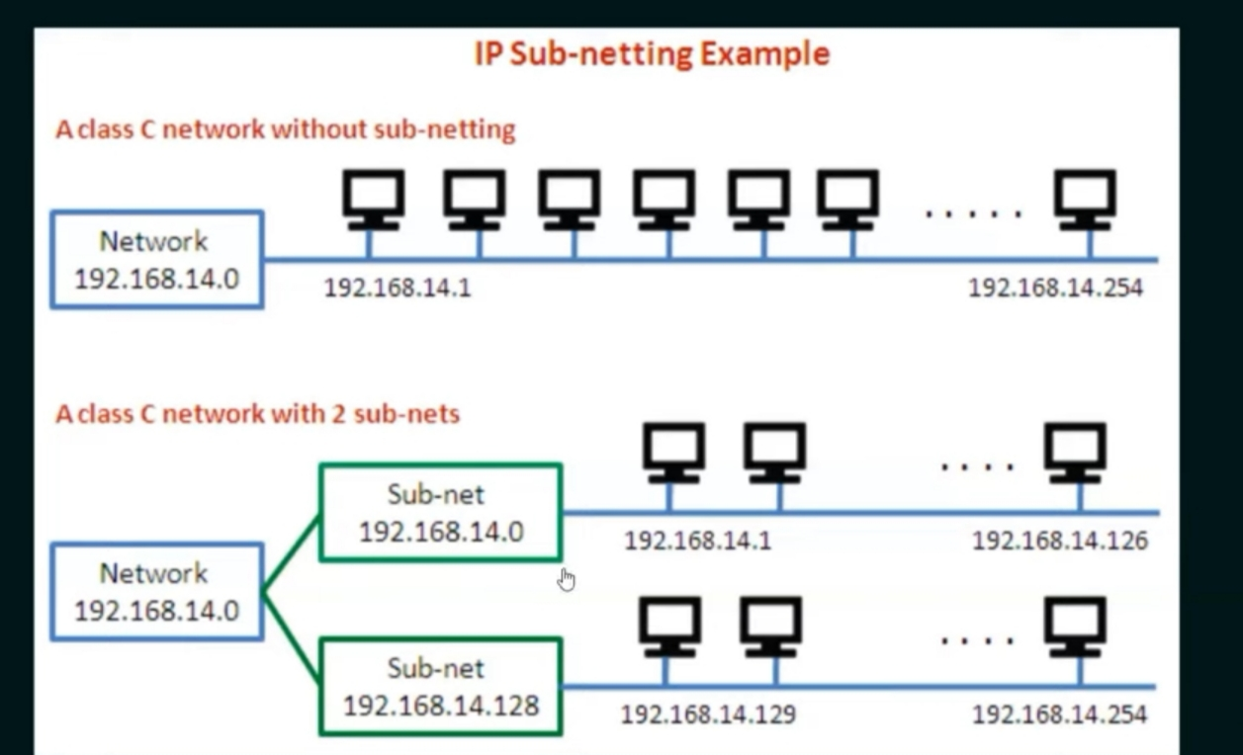

Slide 61
Subnets
The individual smaller network created as a result of subnetting
As the network grows, it is allowed a network to be split into several parts for internal use but still act like a single network to the outside world.
In the Internet literature, the parts of the network (in this case, Ethernets) are called subnets.
To implement subnetting, the main router needs a subnet mask that indicates the split between network + subnet number and host,
Subnet masks are also written in dotted decimal notation, with the addition of a slash followed by the number of bits in the network + subnet part. For the example of Fig. the subnet mask can be written as 255.255.252.0. An alternative notation is /22 to indicate that the subnet mask is 22 bits long.

Slide 62
Problem with classful IP addressing:
  Consider an organization needs about 500 hosts.
  Obviously, the organization will get a Class B license, even though it has far fewer than 64,000 hosts.
  At most, over 64,000 addresses can go unused.
  This results in inefficient usage of the available address-space.
Solution: Use CIDR (Classless Inter Domain Routing).
  CIDR addresses
  reduce the size of routing-tables
  make more IP addresses available within organizations.

Slide 63
CIDR (Classless Interdomain Routing)
The basic idea behind CIDR, is to allocate the remaining IP addresses in variable-sized blocks, without regard to the classes.
CIDR (Classless Inter-Domain Routing) is a system introduced in 1993 to replace the old classful IP addressing system (Classes A, B, and C).
It allows for flexible allocation of IP addresses and efficient routing of packets on the internet.
CIDR allows variable-length subnet masks, so you can choose exactly how many bits are used for the network and host parts.
Using CIDR, each IP address has a network prefix that identifies either one or several network gateways. The length of the network prefix in IPv4.
CIDR is also specified as part of the IP address and varies depending on the number of bits needed, rather than any arbitrary class assignment structure.

Slide 64
CIDR is written as:
<IP address>/<prefix length>
Example:
192.168.1.0/24
/24 means the first 24 bits are network bits.
Subnet mask = 255.255.255.0

Slide 65
NAT
Network Address Translation (NAT) enables hosts to use Internet without the need to have globally unique addresses.
NAT enables organization to have a large set of addresses internally and one address externally.
The organization must have single connection to the Internet through a NAT-enabled router.
NAT allows a single device (such as a router) to act as an agent b/w internet (or "public network") and local (or "private") network.
This means only a single, unique IP address is required to represent an entire group of computers.
The private addresses only have meaning to devices within a given network.
The NAT-enabled router does not look like a router to the outside world.
Instead, the NAT-enabled router behaves to the outside world as a single device with a single IP address.

Slide 67
Internet Control Protocols-
Internet Control Message Protocol (ICMP)
ICMP is used by hosts and routers to communicate network- layer information to each other. The most typical use of ICMP is for error reporting.
ICMP is part of IP but architecturally it lies just above IP hence ICMP messages are carried inside IP datagrams. That is, ICMP messages are carried as IP payload.
ICMP messages have a type and a code field, and contain the header and the first 8 bytes of the IP datagram
The well-known ping program sends an ICMP type 8 code 0 message to the specified host. The destination host, seeing the echo request, sends back a type 0 code 0 ICMP echo reply.
Congested router send an ICMP source quench message to a host to force that host to reduce its transmission rate.

Slide 70
Obtaining a Host Address: DHCP
Two ways to assign an IP address to a host:
1) Manual Configuration
Operating systems allow system-administrator to manually configure IP address.
2) Dynamic Host Configuration Protocol (DHCP)
DHCP enables auto-configuration of IP address to host.

Slide 71
DHCP Protocol
DHCP enables auto-configuration of IP address to host.
DHCP assigns dynamic IP addresses to devices on a network.
Dynamic address allocation is required when a host moves from one network to another or when a host is connected to a network for the first time.
Because of DHCP’s ability to automate the network-related aspects of connecting a host into a network, it is often referred to as a plug-and-play protocol.
DHCP is a client-server protocol.
A client is typically a newly arriving host wanting to obtain network configuration information, including an IP address for itself.
In the simplest case, each subnet will have a DHCP server.
If no server is present on the subnet, a DHCP relay agent (typically a router) that knows the address of a DHCP server for that network.
DHCP server attached to subnet 223.1.2/24, with the router serving as the relay agent for arriving clients attached to subnets 223.1.1/24 and 223.1.3/24.

Slide 73
DHCP server discovery.
The first task of a newly arriving host is to find a DHCP server with which to interact.
This is done using a DHCP discover message, which a client sends within a UDP packet to port 67.
The UDP packet is encapsulated in an IP datagram.
DHCP client creates an IP datagram containing its DHCP discover message along with the broadcast destination IP address of 255.255.255.255 and a “this host” source IP address of 0.0.0.0.
The DHCP client passes the IP datagram to the link layer, which then broadcasts this frame to all nodes attached to the subnet.

Slide 74
DHCP server offer(s).
A DHCP server receiving a DHCP discover message responds to the client with a DHCP offer message that is broadcast to all nodes on the subnet, again using the IP broadcast address of 255.255.255.255.
DHCP server broadcasts DHCPOFFER message containing
1. Client's IP address
2. Network mask
3. IP address lease time (i.e. the amount of time for which the IP address will be valid).

Slide 75
DHCP request.
The newly arriving client will choose from among one or more server offers and respond to its selected offer with a DHCP request message, echoing back the configuration parameters.
DHCP ACK.
The server responds to the DHCP request message with a DHCP ACK message, confirming the requested parameters.

Slide 76
ARP—The Address Resolution Protocol
ARP is used to map an IP address to a physical (MAC) address on a local network.
It is defined in RFC 826 and is used by almost every machine on the Internet.
ARP simplifies configuration since only IP addresses and subnet masks need to be assigned.
When a host sends a packet, ARP helps find the receiver’s Ethernet address and builds the frame for transmission.
Once a mapping is found, it is stored in an ARP cache to avoid repeating the same broadcast.

Slide 77
Hosts can learn each other’s IP-to-MAC mappings from ARP replies, reducing future broadcasts.
When a machine boots, it can broadcast its mapping to fill ARP caches and detect duplicate IP addresses.
ARP cache entries automatically expire after a few minutes to allow updates if hardware changes.
If the destination is on another network, a router can respond to ARP requests on behalf of remote hosts—this is proxy ARP.
For distant networks, packets are sent to the default router, which uses routing tables and ARP on other networks to deliver them to the final host.

Slide 78
small university with several class C (now called /24) networks is illustrated. Here we have two Ethernets, one in the Computer Science Dept., with IP address 192.31.65.0 and one in Electrical Engineering, with IP address 192.31.63.0.
These are connected by a campus backbone ring (e.g., FDDI) with IP address 192.31.60.0. Each machine on an Ethernet has a unique Ethernet address, labeled E1 through E6, and each machine on the FDDI ring has an FDDI address, labeled F1 through F3.

Slide 79
A better solution is for host 1 to output a broadcast packet onto the Ethernet asking: Who owns IP address 192.31.65.5?
The broadcast will arrive at every machine on Ethernet 192.31.65.0, and each one will check its IP address. Host 2 alone will respond with its Ethernet address (E2).
In this way host 1 learns that IP address 192.31.65.5 is on the host with Ethernet address E2. The protocol used for asking this question and getting the reply is called ARP (Address Resolution Protocol). Almost every machine on the Internet runs it.
The advantage of using ARP over configuration files is the simplicity. The system manager does not have to do much except assign each machine an IP address and decide about subnet masks. ARP does the rest.

Slide 80
At this point, the IP software on host 1 builds an Ethernet frame addressed to E2, puts the IP packet (addressed to 192.31.65.5) in the payload field, and dumps it onto the Ethernet. The Ethernet board of host 2 detects this frame, recognizes it as a frame for itself, scoops it up, and causes an interrupt. The Ethernet driver extracts the IP packet from the payload and passes it to the IP software, which sees that it is correctly addressed and processes it.
Ex: host 1 wants to send a packet to host 4 (192.31.63.8). Using ARP will fail because host 4 will not see the broadcast (routers do not forward Ethernet-level broadcasts). There are two solutions. First, the CS router could be configured to respond to ARP requests for network 192.31.63.0 (and possibly other local networks). In this case, host 1 will make an ARP cache entry of (192.31.63.8, E3) and happily send all traffic for host 4 to the local router. This solution is called proxy ARP.

Slide 81
OSPF—The Interior Gateway Routing Protocol
The Internet consists of many autonomous systems (ASes), each managed by different organizations using their own internal routing methods.
Routing within an AS uses an Interior Gateway Protocol (IGP), while routing between ASes uses an Exterior Gateway Protocol (EGP).
The original IGP used in the Internet was RIP (Routing Information Protocol), a distance vector protocol based on the Bellman-Ford algorithm.
RIP worked for small networks but had issues like slow convergence and the count-to-infinity problem as networks grew larger.
To overcome these issues, RIP was replaced in 1979 by a link state protocol, and later improved to OSPF (Open Shortest Path First) in 1990.
OSPF was developed by the Internet Engineering Task Force (IETF) and is defined in RFC 2328.

Slide 82
Requirements for OSPF
First, the algorithm had to be published in the open literature, hence the ''O'' in OSPF. publicly available, not proprietary.
Second, the new protocol had to support a variety of distance metrics, including physical distance, delay, and so on.
Third, it had to be a dynamic algorithm, one that adapted to changes in the topology automatically and quickly.
Fourth, and new for OSPF, it had to support routing based on type of service. The new protocol had to be able to route real-time traffic one way and other traffic a different way.
Fifth, and related to the above, the new protocol had to do load balancing, splitting the load over multiple lines
Sixth, support for hierarchical systems was needed.
Seventh, some level of security was required

Slide 83
Area is a network or a set of contiguous networks.
Every AS has a backbone area, called area 0. All areas are connected to the backbone, possibly by tunnels,
OSPF distinguishes four classes of routers:
1. Internal routers are wholly within one area.
2. Area border routers connect two or more areas.
3. Backbone routers are on the backbone.
4. AS boundary routers talk to routers in other ASes.

Slide 85
OSPF represents the entire network as a directed graph, where routers and networks are nodes connected by arcs with assigned costs such as distance or delay.
It calculates the shortest path between routers using the link costs to determine the most efficient routes.
Large networks are divided into areas, each containing routers and networks that are close together to simplify routing management.
Every OSPF system has a backbone area (area 0) that connects all other areas, and all interarea communication passes through this backbone.
Routers that connect multiple areas are known as area border routers, while those on the backbone are called backbone routers.
OSPF supports three types of routing: intra-area (within an area), interarea (between areas), and inter-AS (between different autonomous systems).

Slide 86
Using flooding, each router informs all the other routers in its area of its neighbors and costs.
This information allows each router to construct the graph for its area(s) and compute the shortest path. The backbone area does this too.
In addition, the backbone routers accept information from the area border routers in order to compute the best route from each backbone router to every other router. This information is propagated back to the area border routers, which advertise it within their areas.

Slide 87
BGP—The Exterior Gateway Routing Protocol
BGP stands for Border Gateway Protocol, which is used to exchange routing information between different Autonomous Systems (ASes) on the Internet.
It acts as an Exterior Gateway Protocol (EGP), meaning it operates between organizations or administrative domains, not within them.
In contrast, Interior Gateway Protocols (IGPs) like OSPF or RIP are used inside a single AS to manage internal routing efficiently.
The main objective of BGP is to manage routing between organizations that have their own policies, rather than just finding the shortest or quickest path.
BGP takes into account political, economic, and security considerations when selecting routes between different networks.

Slide 88
For instance, some networks may refuse to carry transit traffic between foreign networks or may only carry traffic for paying customers.
Such routing decisions are manually configured by network administrators and are not automatically handled by the BGP protocol itself.
From a BGP router’s point of view, the Internet looks like a graph of multiple ASes interconnected through border routers.
Two ASes are considered connected if there is a physical or logical link between their border routers.
BGP networks are divided into three categories based on how they handle transit traffic: stub, multiconnected, and transit networks.
  Stub networks have only one connection to another AS and therefore cannot carry traffic for other networks.
  Multiconnected networks have multiple external connections but do not allow transit traffic to pass through them.
  Transit networks, such as Internet backbones, allow data from other networks to pass through, often for commercial reasons.

Slide 89
BGP routers exchange routing information using TCP connections, which ensure reliable delivery and error-free communication.
Unlike traditional distance vector protocols such as RIP, BGP advertises the entire AS path to a destination rather than just the cost or distance.
This path information allows routers to clearly identify the route that data will take and helps in detecting routing loops.
When multiple routes are available, BGP uses a scoring system based on local administrative preferences to select the best path.
Any route that violates an organization’s policy is given an infinite cost and is automatically discarded.
Because BGP routers know complete paths, they can easily detect loops and avoid the count-to-infinity problem common in simpler distance vector protocols.
BGP serves as the policy-based backbone of interdomain routing, allowing millions of networks to interconnect globally while following their own business, political, and security policies — as formally defined in RFCs 1771 to 1774.

Slide 90
After all the paths come in from the neighbors, F examines them to see which is the best. It quickly discards the paths from I and E, since these paths pass through F itself. The choice is then between using B and G. Every BGP router contains a module that examines routes to a given destination and scores them, returning a number for the ''distance'' to that destination for each route.

Slide 91
IPv6
Its major goals were:
1. Support billions of hosts, even with inefficient address space allocation.
2. Reduce the size of the routing tables.
3. Simplify the protocol, to allow routers to process packets faster.
4. Provide better security (authentication and privacy) than current IP.
5. Pay more attention to type of service, particularly for real-time data.
6. Aid multicasting by allowing scopes to be specified.
7. Make it possible for a host to roam without changing its address.
8. Allow the protocol to evolve in the future.
9. Permit the old and new protocols to coexist for years.

Slide 92
A modified combined version of the Deering and Francis proposals, by now called SIPP (Simple Internet Protocol Plus) was selected and given the designation IPv6.
IPv6 meets the goals fairly well. It maintains the good features of IP, discards or deemphasizes the bad ones, and adds new ones where needed.
In general, IPv6 is not compatible with IPv4, but it is compatible with the other auxiliary Internet protocols, including TCP, UDP, ICMP, IGMP, OSPF, BGP, and DNS, sometimes with small modifications being required

Slide 93
The main features of IPv6:
1)IPv6 has longer addresses than IPv4. They are 16 bytes long, which solves the problem that IPv6 set out to solve: provide an effectively unlimited supply of Internet addresses.
2) simplification of the header. It contains only seven fields (versus 13 in IPv4). This change allows routers to process packets faster and thus improve throughput and delay.
3)The third major improvement was better support for options. This change was essential with the new header because fields that previously were required are now optional. In addition, the way options are represented is different, making it simple for routers to skip over options not intended for them. This feature speeds up packet processing time.
4) IPv6 represents a big advance is in security.
5)more attention has been paid to quality of service.

Slide 95
The Version field is always 6 for IPv6 (and 4 for IPv4).
The Traffic class field is used to distinguish between packets with different real-time delivery requirements.
The Flow label field provides a way for a source and destination to mark groups of packets that have the same requirements and should be treated in the same way by the network,

Slide 96
The Payload length field tells how many bytes follow the 40-byte header .The name was changed from the IPv4 Total length field because the meaning was changed slightly: the 40 header bytes are no longer counted as part of the length.
The Next header field :The reason the header could be simplified is that there can be additional (optional) extension headers. This field tells which of the (currently) six extension headers, if any, follow this one. If this header is the last IP header, the Next header field tells which transport protocol handler (e.g., TCP, UDP) to pass the packet to.

Slide 97
The Hop limit field is used to keep packets from living forever. It is, in practice, the same as the Time to live field in IPv4, namely, a field that is decremented on each hop.
Next come the Source address and Destination address fields. Deering's original proposal, SIP, used 8-byte addresses, but during the review process many people felt that with 8-byte addresses IPv6 would run out of addresses within a few decades, whereas with 16-byte addresses it would never run out.
Finally, the Checksum field is gone because calculating it greatly reduces performance

